Slide 1

Enhancing U-Net for PCB Segmentation Using Hyperspectral Imaging in E-waste Recycling
School of Mechanical and Control Engineering
Bachelor’s Thesis Presentation
Thesis Advisor: Prof. Young-keun, Kim
21900575 Lee ChanKeun
Notes:
Good morning. I’m Lee Chankeun. Today I present ‘Enhancing U-Net for PCB Segmentation Using Hyperspectral Imaging in E-Waste Recycling.’ This work was completed as my bachelor’s thesis under Prof. Young-keun Kim

Slide 2
Table of Contents
1. Introduction
2. Datasets and Methods
3. Results
4. Discussion
5. Conclusion
Notes:
The talk follows five chapters that mirror the thesis: (1) Introduction, (2) Materials & Methods, (3) Results, (4) Discussion, and (5) Conclusion. Let’s begin with why PCB recycling needs better vision systems.”

Slide 3
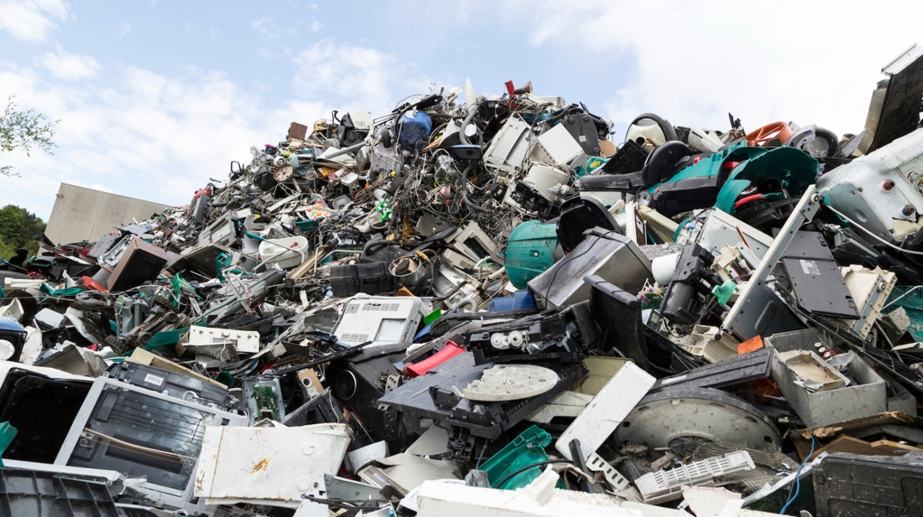
1. Introduction
Background and Motivation
Notes:
Global generation of electronic waste(E-waste) surpassed 62 million tonnes in 2024 and is projected to grow at roughly 3 % annually [1]. Printed-circuit boards (PCBs) constitute only ~3 % of this mass, yet they contain > 40 % of the recoverable precious and base metals—including gold, palladium, copper, and tin [2]. Inadequate recycling not only forfeits these critical resources but also releases brominated flame retardants, lead, and dioxins into the environment. Automated optical systems capable of localizing and classifying heterogeneous PCB components are therefore pivotal for (i) economic metal recovery, (ii) pollution avoidance, and (iii) meeting circular-economy directives.

Slide 4
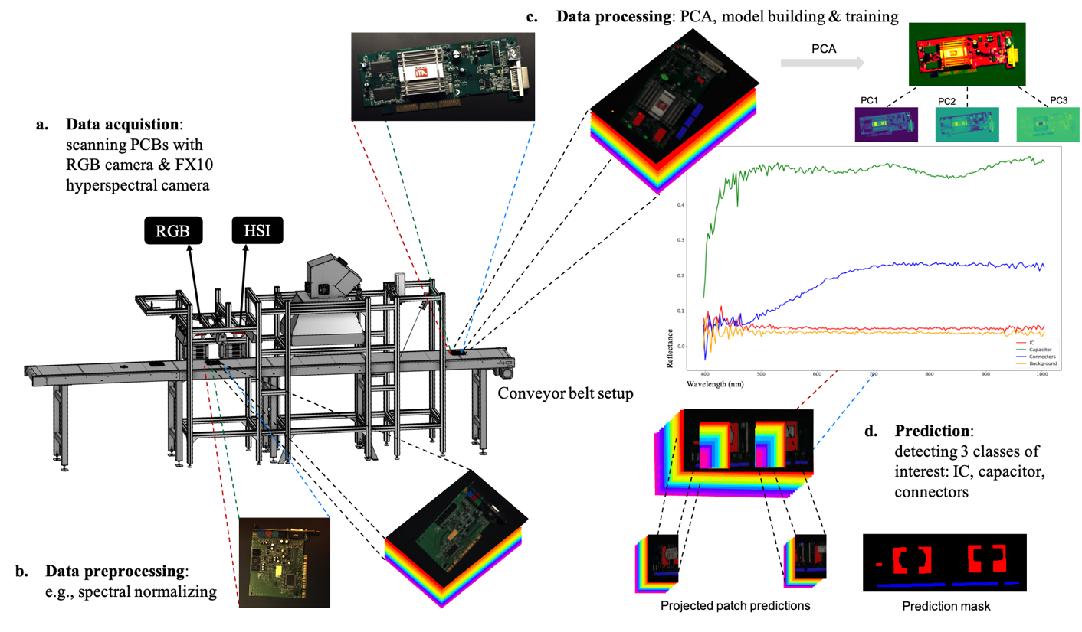
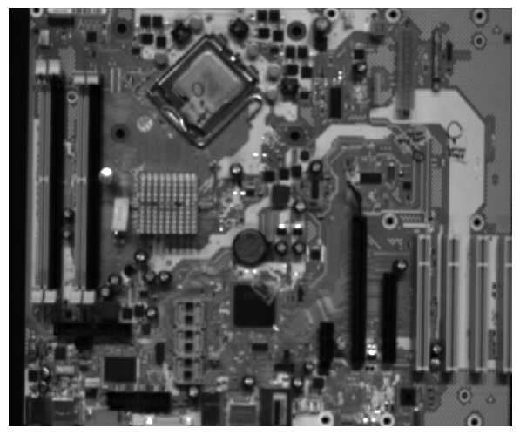
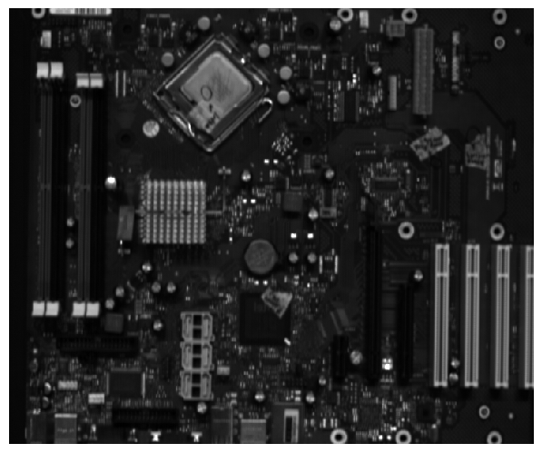
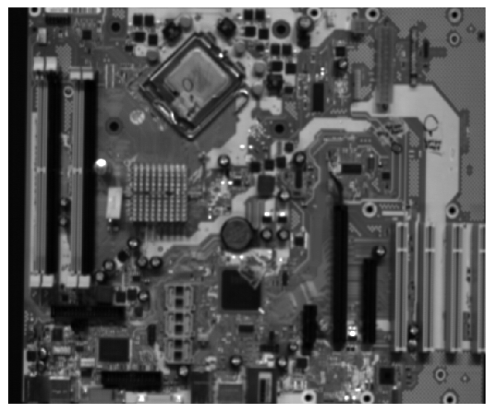
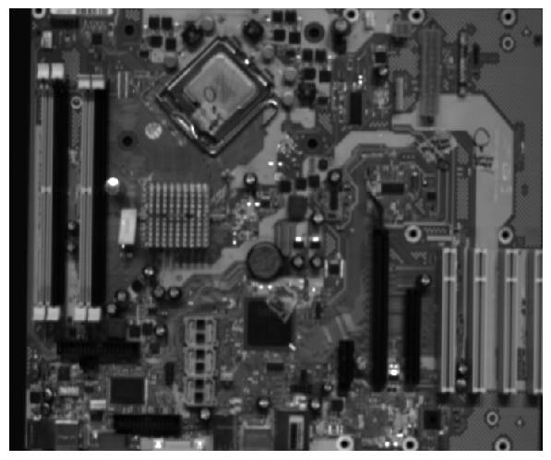
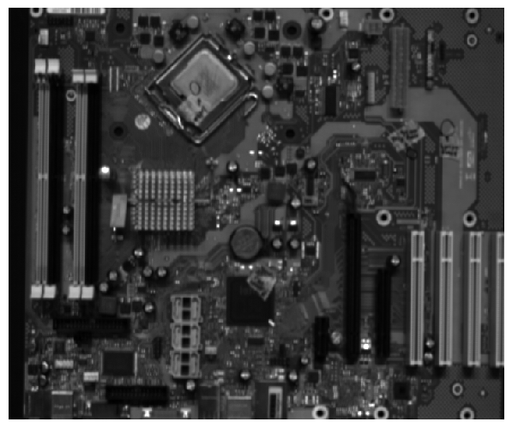
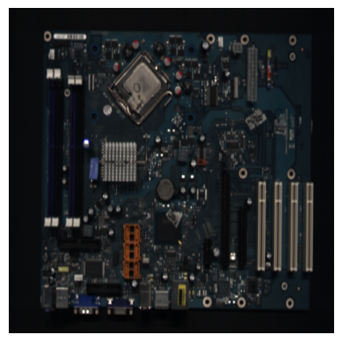
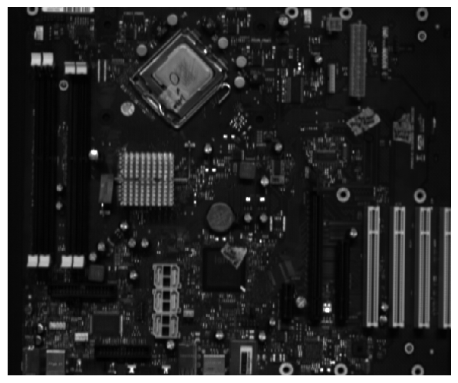
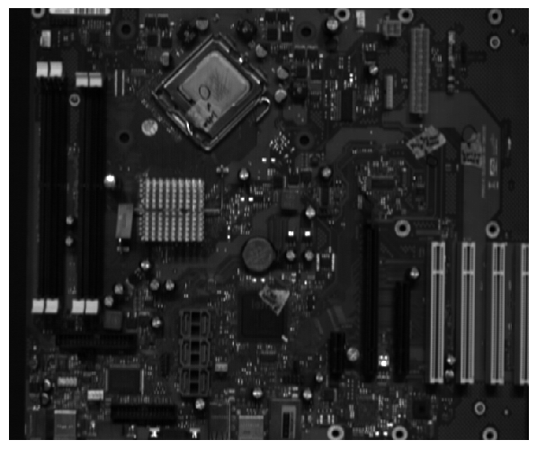
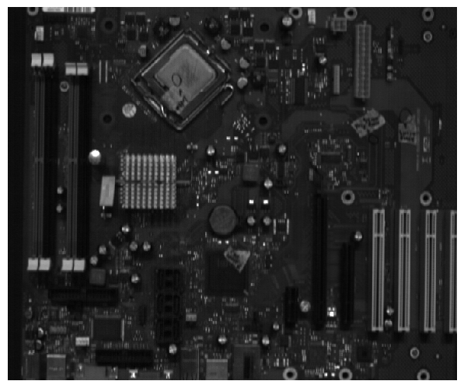
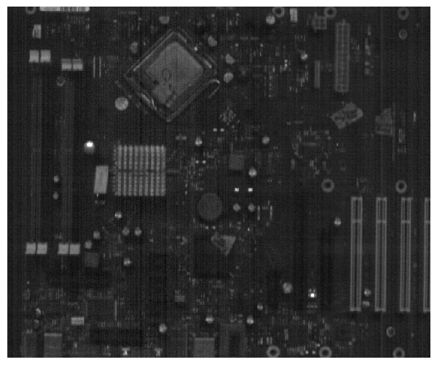
1. Introduction
950~955nm
675~680nm
400~405nm
Notes:
Conventional RGB cameras record three wide bands (≈ 60 nm each) centered in the visible range. Many PCB elements—e.g., copper traces, aluminum capacitor cans, and epoxy-encapsulated ICs—exhibit nearly identical colors under broadband illumination, making them difficult to separate with RGB imagery alone. Hyperspectral imaging (HSI) addresses this limitation by acquiring a spectral cube $I ∈ ℝ^{H×W×L}$ in which every pixel is associated with a high-resolution reflectance spectrum across L=214 narrow bands (400–1000 nm in the PCB-Vision dataset).
Spectral features—such as copper’s absorption edge near 540 nm or polymer overtone peaks at 880–940 nm—enable material-level discrimination that RGB cannot deliver. However, naively feeding the entire 214-band cube into a convolutional network inflates memory usage and FLOPs, forcing previous PCB-Vision studies to (i) train on small image patches that discard global context, or (ii) compress the cube with linear principal-component analysis (PCA), which can suppress minority-class variance.
The present work aims to reconcile HSI’s rich material information with the computational constraints of real-time recycling lines. Specifically:
Design a Spectrum Channel Reduction Block(SCRB)—a lightweight, learnable $1 × 1$ convolutional module that compresses 214 input channels to three, enabling full-frame processing without patch extraction or linear PCA.
Benchmark three input strategies—Full-Cube (Baseline #1), PCA-3 (Baseline #2), and SCRB (Proposed)—on identical splits of the PCB-Vision dataset (Train 126 / Val 3 / Test 30) using U-Net–family backbones.
Provide a evaluation that spans per-class metrics(F1 Score, IoU) and computational cost (GFLOPs), thereby establishing a realistic baseline for HSI segmentation.
Collectively, these contributions demonstrate that adaptive channel reduction can preserve or improve segmentation accuracy while reducing model weight and inference latency, advancing the feasibility of hyperspectral PCB recycling in industrial settings.

Slide 5
2. Datasets and Methods
Strategy | Channel Count | Relation to original paper
Baseline #1(Full-Cube) | 214 bands | New – removes the patch constraint by leveraging higher GPU memory; serves as an upper-bound reference.
Baseline #2(PCA-3) | 3 bands (PCA preprocessed data) | Matches the PCA experiment in PCB-Vision after resizing; provides the lower-bound reference.
Proposed(Spectrum Channel Reduction Block) | 214 bands(214 – 128 - 3) | Replaces off-line PCA by an in-network, non-linear compression (SCRB).
Notes:
The original PCB-Vision study reported two separate experiments:
Full-spectrum input (214 bands) - images cropped into 128 × 128 patches to fit GPU memory.
PCA input (3 bands) - each cube resized to 640 × 640 and fed to the network end-to-end.
This work benchmarks three mutually exclusive input pipelines; their relationship to the original PCB-Vision settings is summarized in Table 1

Slide 6
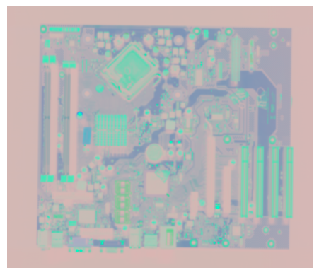


2. Datasets and Methods
Baseline #1(Full-Cube)
Baseline #2(PCA-3)
Spectrum Channel Reduction Block (Proposed)
214 channels
$$640×640×214$$
$$640×640×3$$
Spectrum Channel Reduction Block
Backbone Deep Learning Model
Notes:
2.2.1 Baseline #1(Full-Cube)
All 214 spectral bands are supplied to the backbone without dimensionality reduction. Compared with the patch-based approach, this full-frame setup delivers richer spatial context at the cost of a larger first convolution
2.2.2 Baseline #2(PCA-3)
Each 214-dimensional spectrum is projected onto the top three principal components computed over the training set (98.7 % variance retained). The resulting 3-channel tensor mimics RGB and inherits the low memory footprint of the original PCB-Vision PCA pipeline
2.2.3 Spectrum Channel Reduction Block (Proposed)
The proposed SCRB comprises two sequential 1 × 1 convolutions (214 → 128 → 3) with BatchNorm and ReLU. Because the weights are learned jointly with segmentation loss, the network can preserve minority-class wavelengths that linear PCA may suppress. The SCRB variant shares the same full-frame resolution as Baselines #1 and #2, ensuring that performance differences stem solely from spectral handling.

Slide 7
2. Datasets and Methods
214
3
64
128
64
4
HSI-Input
640x640
Spectrum Channel Reduction Block
640x640
640x640
640x640
640x640
640x640
128
3
128
128
128
128
320x320
320x320
320x320
Spectrum Channel Reduction Block
256
640x640
256
640x640
160x160
160x160
160x160
160x160
256
512
256
80x80
80x80
512
Copy and crop
1024
Max pool 2x2
40x40
Double CONV, ReLU
Up-CONV 2x2
CONV 1x1
Notes:
Consistent with the original PCB-Vision study, we evaluate three mainstream encoder–decoder backbones and attach our Spectrum Channel Reduction Block(SCRB) in front of each. Detailed layer-by-layer descriptions can be found in the PCB-Vision appendix
Apart from attaching the SCRB module (214 → 128 → 3 channels) ahead of the encoder, all hyper-parameters—filter widths, depth (4 down–up stages), activation (ReLU), and final 1 × 1 soft-max layer—match the PCB-Vision configuration. Thus any performance difference from the input strategy rather than architectural tweaks

Slide 8
2. Datasets and Methods
Item | Setting
Hardware | Windows 11, Python 3.12, PyTorch 2.7, CUDA 12.8, single NVIDIA RTX A6000(48 GB)
Epochs/ Batch size | 100 epochs, batch 8
Loss | Weighted cross-entropy, class weights = [0.1, 0.7, 0.95, 0.8]
Early stopping | Patience = 20 epochs on validation loss
Data augmentation | 90° rotations, horizontal + vertical flips (p = 0.5 each)
Dataset split | Train 126, Validation 3, Test 30 (identical across all inputs)
Notes:
The learning schedule mirrors the PCB-Vision baseline to ensure comparability.

Slide 9
3. Results
Metric | Base Architecture | SCRB | Others | IC | Capacitor | Connectors
F1 Score | U-net | Baseline #1 Baseline #2 Proposed | 0.95 0.95 0.96 | 0.75 0.27 0.67 | 0.57 0.23 0.58 | 0.31 0.05 0.46
 | Attention U-net | Baseline #1 Baseline #2 Proposed | 0.97 0.94 0.96 | 0.71 0.25 0.70 | 0.65 0.23 0.36 | 0.66 0.10 0.54
 | ResU-net | Baseline #1 Baseline #2 Proposed | 0.96 0.94 0.97 | 0.74 0.14 0.72 | 0.53 0.16 0.56 | 0.51 0.02 0.71
Metric | Base Architecture | SCRB | Others | IC | Capacitor | Connectors
IoU | U-net | Baseline #1 Baseline #2 Proposed | 0.91 0.95 0.93 | 0.60 0.27 0.51 | 0.40 0.23 0.41 | 0.18 0.05 0.30
 | Attention U-net | Baseline #1 Baseline #2 Proposed | 0.95 0.90 0.93 | 0.56 0.14 0.54 | 0.49 0.13 0.22 | 0.49 0.05 0.37
 | ResU-net | Baseline #1 Baseline #2 Proposed | 0.94 0.90 0.94 | 0.59 0.07 0.56 | 0.36 0.08 0.39 | 0.34 0.01 0.55
Notes:
Others remain saturated (≥ 0.93 IoU) for all inputs, indicating that background pixels are easily recoverable. IC class sees a modest 5–9 % absolute drop when switching from Baseline #1 to Proposed. Attribute this to slight attenuation of high-frequency spectra that characterize epoxy encapsulants. Capacitor and Connector benefit most from SCRB; IoU increases by +0.21 (Cap) and +0.54 (Conn) compared with Baseline #2 and even surpass Baseline #1

Slide 10
3. Results
Base Architecture | SCRB | GFLOPs | Params(M)
U-net | Baseline #1 Baseline #2 Proposed | 392.12 342.86 353.83 | 31.16 31.30 31.07
Attention U-net | Baseline #1 Baseline #2 Proposed | 466.67 417.49 428.57 | 35.0 35.14 34.91
ResU-net | Baseline #1 Baseline #2 Proposed | 606.03 506.99 518.06 | 13.29 13.30 13.07
Base Architecture | SCRB | mIoU | Mean F1 Score
U-net | Baseline #1 Baseline #2 Proposed | 0.52 0.37 0.53 | 0.64 0.37 0.66
Attention U-net | Baseline #1 Baseline #2 Proposed | 0.62 0.30 0.51 | 0.74 0.38 0.64
ResU-net | Baseline #1 Baseline #2 Proposed | 0.55 0.26 0.61 | 0.68 0.31 0.74
Notes:
Accuracy trend. Across backbones, Proposed recovers
B ≥ 82 % of Baseline #1’s mIoU while more than 1.5 times Baseline #2’s score. Efficiency trend. GFLOPs drop ≈ 10 % versus the Baseline #1 models.

Slide 11
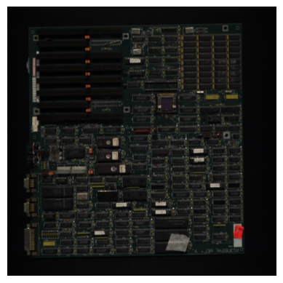
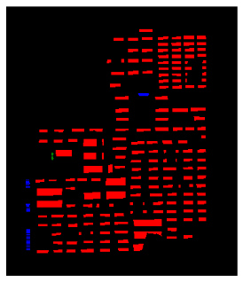
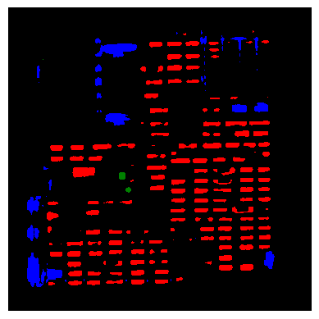
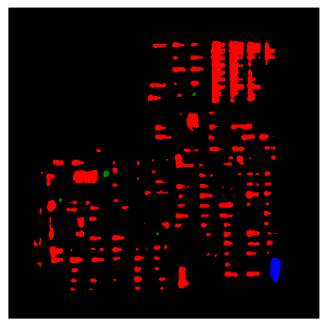
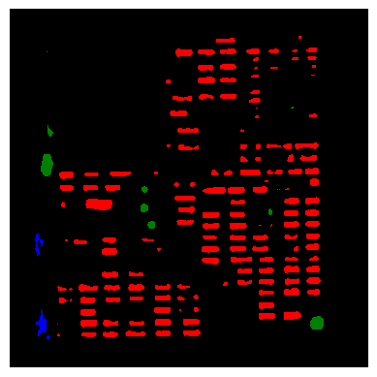
3. Results
Original Image
Ground Truth Mask
Baseline #1
Baseline #2
Proposed
Notes:
< Visualized Segmentation Result(Attention U-Net) >
Qualitatively, Proposed combines the spatial coherence of full-frame training with spectral selectivity superior to linear PCA, leading to cleaner masks and especially better delineation of small connectors.

Slide 12
4. Discussion
Computational efficiency
U-Net. SCRB trims ≈ 10 % of the GFLOPs relative to the 214-band baseline (353.8 vs 392.1 G) while even shaving a small number of weights (31.07 M vs 31.16 M).
Attention U-Net. A similar reduction (8 %) is observed (428.6 vs 466.7 G) with a negligible 0.3 % parameter drop.
ResU-Net. The absolute saving is largest: 88 GFLOPs (−14 %) compared with Baseline #1.
Notes:
The proposed variant is, as expected, slightly more costly than PCA-3 (Baseline #2) because it learns two extra 1 × 1 convolution layers; however, the $Δ$GFLOPs never exceeds 3% (e.g. 428.6 vs 417.5 G for Attention U-Net). Hence SCRB sits in a desirable spot between the heavy 214-band pipeline and the lightweight yet information-starved PCA alternative

Slide 13
4. Discussion
Segmentation accuracy
U-Net. Mean IoU and F1 climb from 0.37 → 0.53 and 0.37 → 0.66, respectively, eclipsing the original full-band scores (0.52/0.64)
ResU-Net. SCRB delivers the strongest gain: +0.06 mIoU and +0.06 F1 over Baseline #1, turning the residual backbone into the new top performer (0.61 / 0.74).
Attention U-Net. Accuracy drops relative to its 214-band counterpart (−0.11 mIoU, −0.10 F1) yet still almost doubles PCA-3 performance, indicating that attention gates alone cannot compensate for spectra removed by linear PCA but work synergistically with SCRB.
Notes:
Table 6 confirms that adaptive channel reduction recovers— and in two cases surpasses—full-spectrum accuracy while obliterating the severe degradation seen with PCA-3:

Slide 14
4. Discussion
Backbone-specific observations
1. Residual connections benefit most from SCRB
2. Attention gating adds value only when spectral cues remain intact.
3. Parameter counts are stable
Limitations and future work
IC class still lags
Dataset Scale
Notes:
Residual connections benefit most from SCRB. The ResU-Net encoder has deeper paths; by discarding noisy bands up-front, SCRB apparently reduces overfitting and lets residual blocks focus on spatial context, yielding the highest overall scores.
Attention gating adds value only when spectral cues remain intact. With PCA the gate receives heavily mixed features and struggles, whereas with SCRB it regains much of its intended selectivity.
Parameter counts are stable. Because SCRB affects only the first two 1 × 1 layers, total weights fluctuate by < 1 %, ensuring that memory savings originate chiefly from narrower feature maps—not model size.
IC class still lags. Although SCRB restores or improves mean metrics, it remains ≈ 5 % absolute behind Baseline #1 on IC IoU (see per-class table in § 3.1). Future work will investigate spectral-attention modules that dynamically re-weight learned channels per pixel.
Dataset scale. The Train set comprises 126 full images—considerably larger than the 128 × 128 patch count used in Baseline #1 but still modest for deep residual models. Semi-supervised pre-training on unlabeled HSI could further stabilize performance

Slide 15
5. Conclusion
Cut floating-point operations by 8–14 % relative to the 214-band models,
Doubled mean IoU and F1 with respect to linear PCA input
Notes:
bridged HSI’s rich 214-band data with real-time constraints by adding a tiny Spectrum Channel Reduction Block that learns the best three bands. This cut compute 8–14 %, kept full-frame accuracy—and even doubled mIoU over PCA—while cleaning up connector errors. Although IC pixels still need spectral-attention tuning, SCRB makes embedded hyperspectral PCB sorting realistic and greener.

